Slide 1
K-Means Clustering

Slide 2
K-Means is an unsupervised machine learning algorithm used for clustering.
It partitions data into K clusters by minimizing the variance within each cluster.
The algorithm iteratively refines the cluster assignments based on the mean of each cluster.

Slide 3
Steps of K-Means Algorithm
Choose the number of clusters (K): Define how many clusters you want.
Initialize centroids: Randomly select K points as initial cluster centers.
Assign each data point to the nearest centroid: Based on Euclidean distance.
Update centroids: Compute the mean of the data points assigned to each cluster.
Repeat Steps 3 and 4: Until centroids do not change significantly.

Slide 4
K-Means Clustering: Step-by-Step Problem
Point | X | Y
A | 2 | 10
B | 2 | 5
C | 8 | 4
Step 1: Initialize K (number of clusters)We choose K = 2, meaning we will form 2 clusters.
Step 2: Select Initial Centroids
We randomly select two points as initial centroids.
Let's assume:
Centroid 1 (C1) = (2,10)
Centroid 2 (C2) = (8,4)

Slide 5

Step 3: Assign Each Point to the Nearest Centroid
We use Euclidean Distance formula to calculate the distance between each point and the centroids:

Slide 6
Point | Distance to C1 (2,10) | Distance to C2 (8,4) | Cluster
A (2,10) | 0 | 10 | Assign to C1
B (2,5) | 5 | 6.32 | Assign to C1
C (8,4) | 10 | 0 | Assign to C2
After this step:
Cluster 1 (C1): {A (2,10), B (2,5)}
Cluster 2 (C2): {C (8,4)}

Slide 7

Step 4: Update Centroids
Calculate the new centroid for each cluster by taking the mean of points in the cluster.
C2new=(8,4) (remains the same as it has only one value)
New centroids:
C1 (2, 7.5)
C2 (8, 4)

Slide 8
Step 5: Reassign Points to the New Centroids
Point | Distance to C1 (2,7.5) | Distance to C2 (8,4) | New Cluster
A (2,10) | 2.5 | 10 | C1
B (2,5) | 2.5 | 6.32 | C1
C (8,4) | 10 | 0 | C2
Clusters remain the same.

Slide 9
Step 6: Stop as Centroids Do Not Change
Since the centroids remain the same after iteration 2, the algorithm stops.
Final Clusters:
Cluster 1: A (2,10), B (2,5) → Centroid (2, 7.5)
Cluster 2: C (8,4) → Centroid (8,4)

Slide 10
Key Insights from K-Means Clustering
Customers with similar spending habits are grouped together.
Businesses can use clustering for targeted marketing strategies.
The number of clusters (K) can be determined using the Elbow Method.

Slide 11
The Elbow Method
One of the challenges in K-Means clustering is determining the best number of clusters (K).
The Elbow Method helps identify the optimal K by analyzing the Within-Cluster Sum of Squares (WCSS).

Slide 12

What is WCSS?
Within-Cluster Sum of Squares (WCSS) measures the total variance within clusters. It is computed as:
where:
K = Number of clusters
x = Data point
μi​ = Centroid of cluster Ci​
Lower WCSS means better clustering, but increasing K always decreases WCSS. The Elbow Method finds the best trade-off.

Slide 13
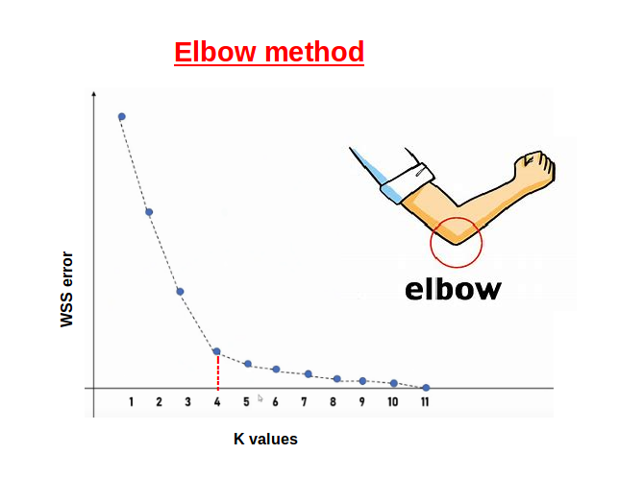
Steps of the Elbow Method
Run K-Means for different values of K (e.g., 1 to 10).
Compute WCSS for each K.Plot WCSS vs. K.
Look for the "Elbow Point"—the point where WCSS stops decreasing significantly.

Slide 14

Silhouette Score for Cluster Validation in K-Means
The Silhouette Score helps evaluate the quality of clustering by measuring how similar each point is to its own cluster compared to other clusters.
What is the Silhouette Score?
where:
a(i) = Average distance from point i to other points in the same cluster (cohesion).
b(i) = Average distance from point i to points in the nearest other cluster (separation).

Slide 15
Silhouette Score range:
+1 → Well-clustered data.
0 → Overlapping clusters.
-1 → Incorrect clustering.

Slide 16
Silhouette Score
for a small dataset with K = 2 clusters.
Step 1: Consider a Small Dataset
Point | X | Y
A | 2 | 3
B | 3 | 3
C | 8 | 7
D | 8 | 6
We use K = 2 clusters, and assume clustering is:
Cluster 1: A (2,3) and B (3,3)
Cluster 2: C (8,7) and D (8,6)

Slide 17
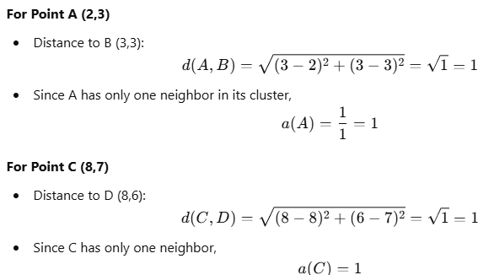
Step 2: Compute Intra-Cluster Distance (a(i))
The intra-cluster distance a(i) is the average distance of a point from all other points in the same cluster.

Slide 18
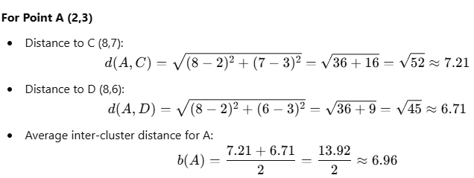
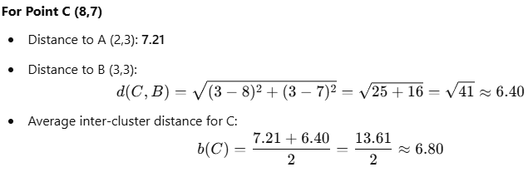
Step 3: Compute Nearest Inter-Cluster Distance (b(i))

Slide 19
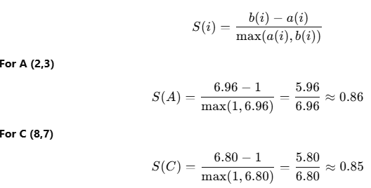

Step 4: Compute Silhouette Score for Each Point
Final Silhouette Score = 0.855 Since the score is close to 1, the clustering is well-formed.
Step 5: Compute Overall Silhouette Score

